Slide 1
Ben Matthews
Ray Tracing

Slide 2
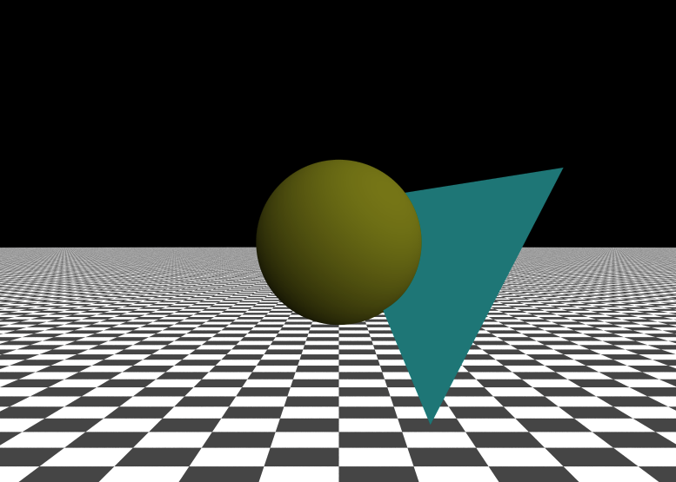
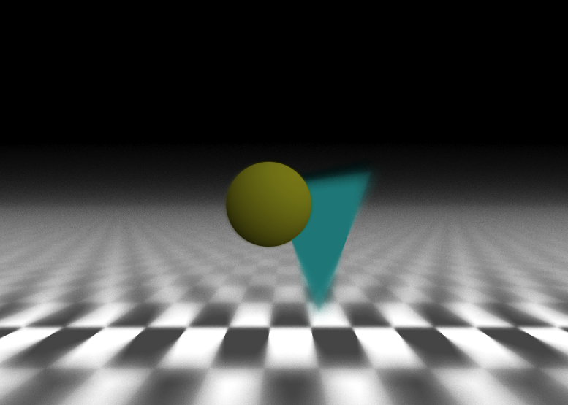
Progression : Lens

Slide 3
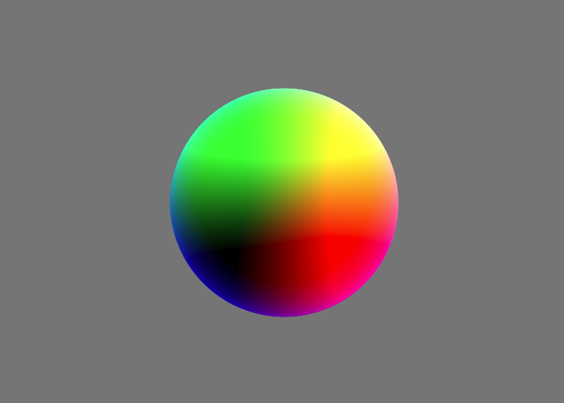
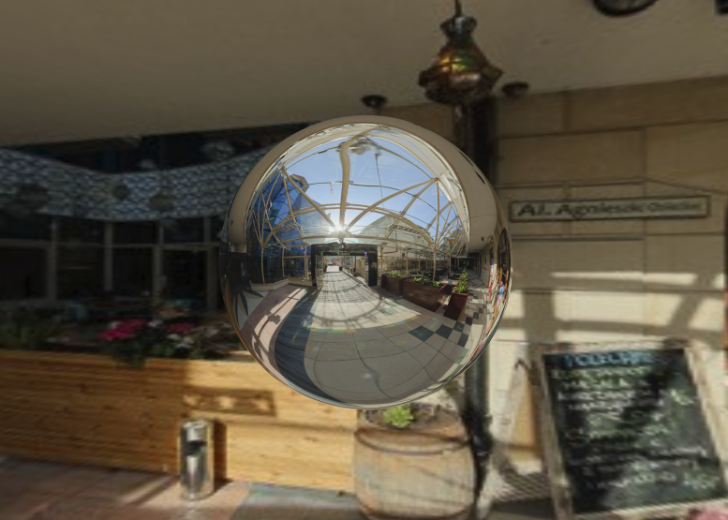
Progression : Reflections

Slide 4
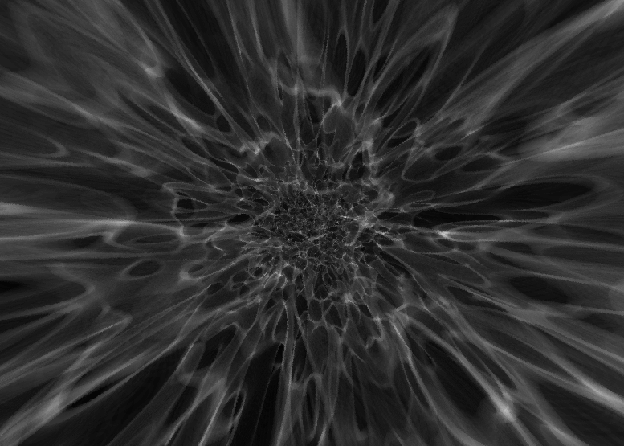

Progression : Effects

Slide 5
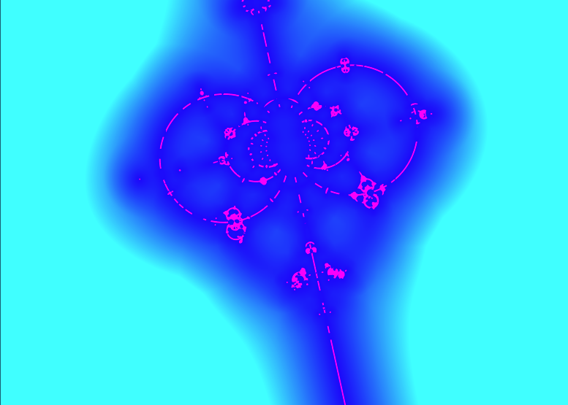
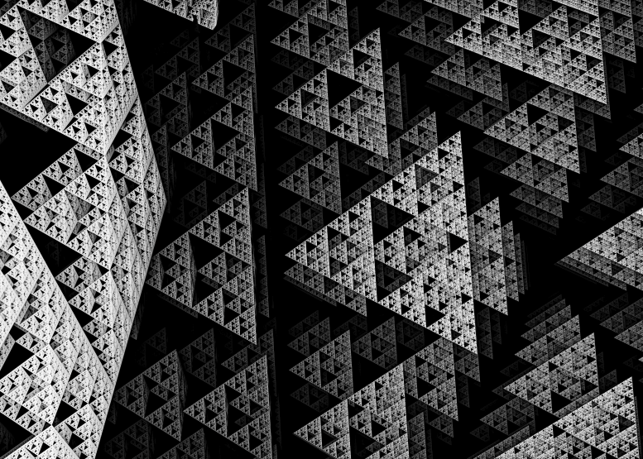
Progression : Fractals

Slide 6
Features:
Camera controls WASD SHIFT SPACE for movement
Mouse arc ball camera
Real time updating (Shaders)

Slide 7
Bugs:
Camera mouse controls
Shaders crashing slow machines

Slide 8
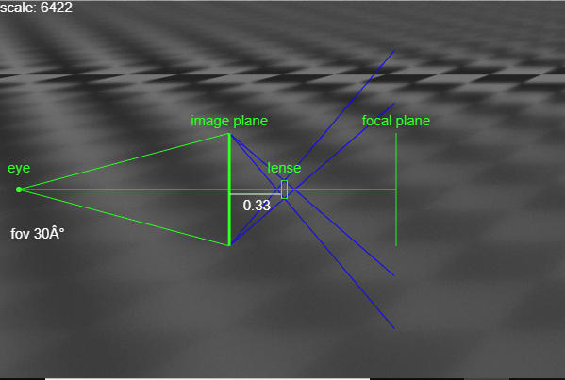
Favorite Feature:

Slide 9
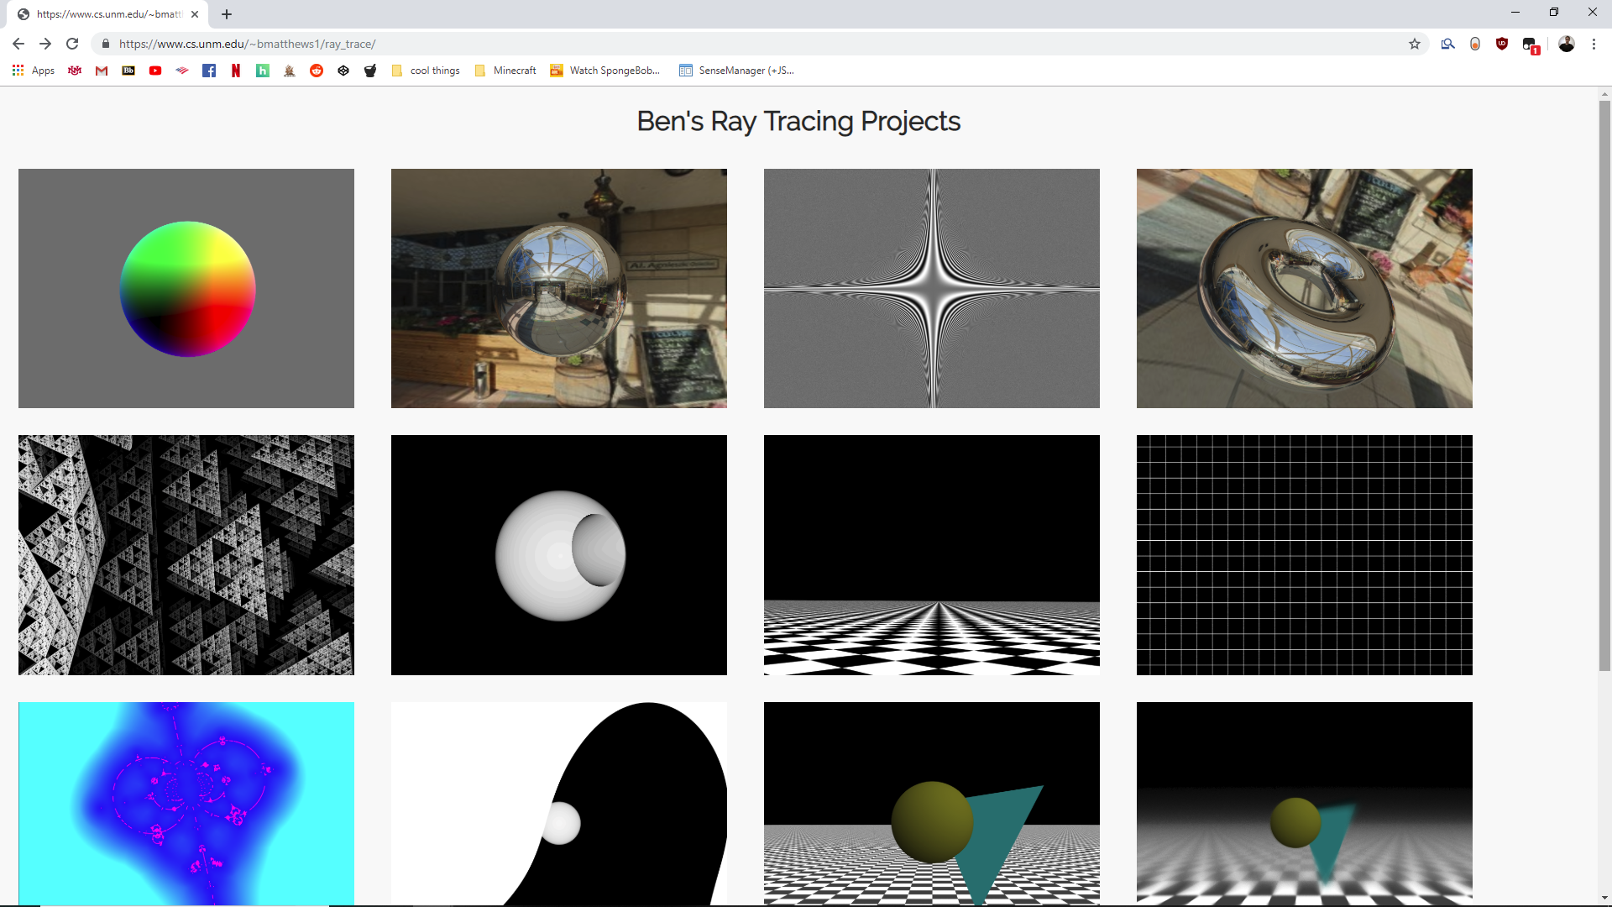
Website: https://www.cs.unm.edu/~bmatthews1/ray_trace/

Slide 10
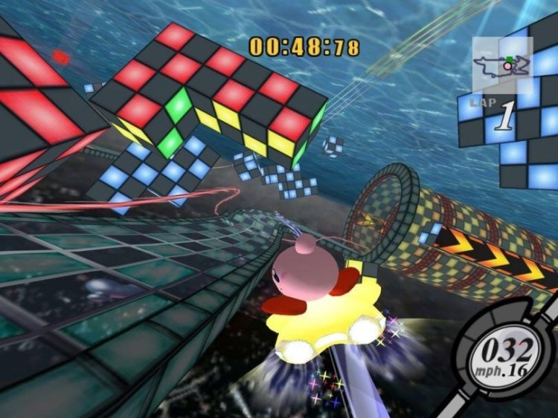
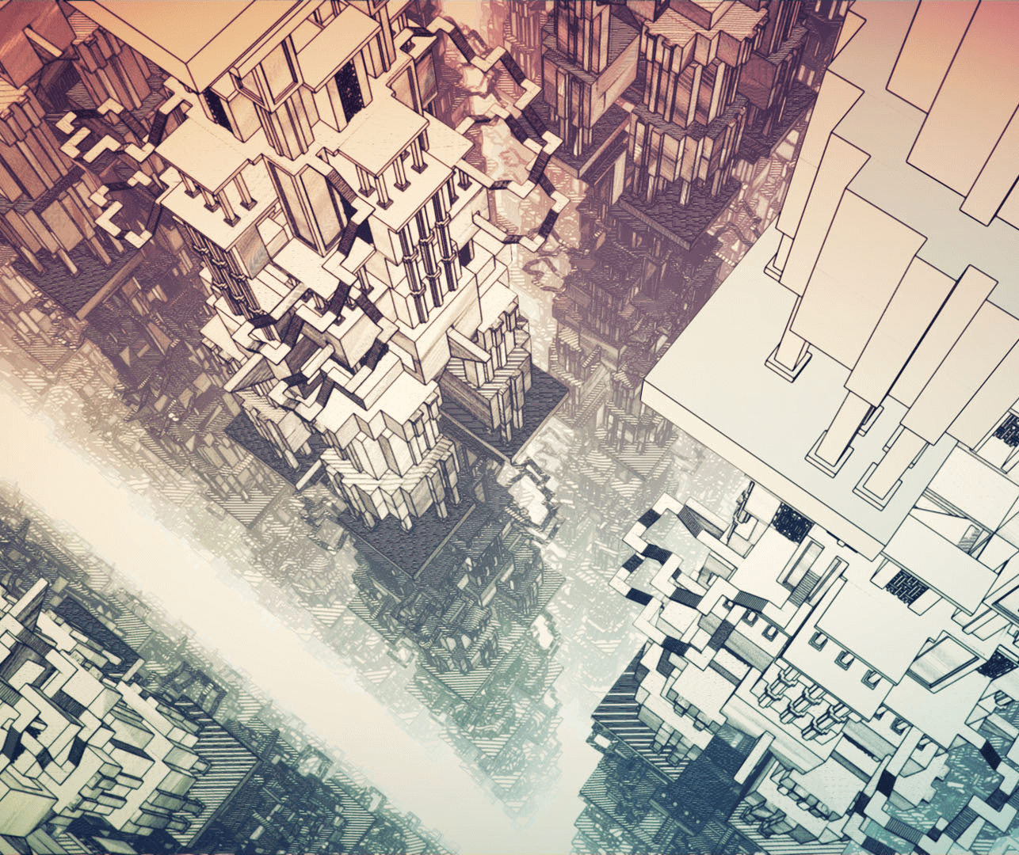
Moving Forward:
Kirby Air Ride
Manifold Garden

